Slide 1

Information Technology
PROJECT
Title – HANDWRITTEN CHARACTER RECOGNIZATION
USING MACHINE LEARNING
Supervisor : SADDAM HUSSAIN
Team Members :
19951A1292 – Y. SHARMISTA REDDY
19951A1297 – A.SHRUTHI
19951A1286 – B. SAMPATH KUMAR

Slide 2
Outline :
OBJECTIVE
INTRODUCTION
ABSTRACT
EXISTING WORK
PROPOSEDWORK
METHODOLOGY
REQUIREMENTS
WORKING
DECODING

Slide 3
Objective :
English is the most commonly used language all over the world. With the increase in necessity, many technologies have evolved in understanding this language.
In this project, we have used optical character recognition (OCR) along with OpenCV and Tesseract to recognize text and display the same text as the output.
OCR was created in response to the rapid advancements in high-level character recognition, and it is now readily available on platforms such as websites and specially built applications.
OCR is a philosophy that aims to make character recognition a built-in feature of a camera module.
The main aim of this project is to make image based text into machine-readable language and print the output.

Slide 4
Abstract :
English is the most widely used language all across the world and it is also considered as an official language among 53countries. Learning English for communication and even writing has always helped people. There are many technologies that came into existence in order to help people learn understand the language English with an ease. Like the voice translation technology, where the language is translated to your own language by just speaking in the microphone. All these technologies have made human’s life little less complicated in terms of communication. What about text? Well, there are technologies for them as well where you copy the sentence and find the results. But what about there is a text on a paper and you need to get that to your word or search the meaning? For that very main thing this project is proposed. In this project, we have used optical character recognition (OCR) along with OpenCV and Tesseract to recognize text and display the same text as the output.OCR was created in response to the rapid advancements in high-level character recognition, and it is now readily available on platforms such as websites and specially built applications. OCR is a philosophy that aims to make character recognition a built-in feature of a camera module. We have used Python language as it is easier to understand and implement.Detailed information about each component and the library we used in this project is mentioned in the upcoming chapters.
Keywords :Optical Character Recognition (OCR), Raspberry pi, pi camera, pixels, Python, Numpy, segmentation, extraction

Slide 5
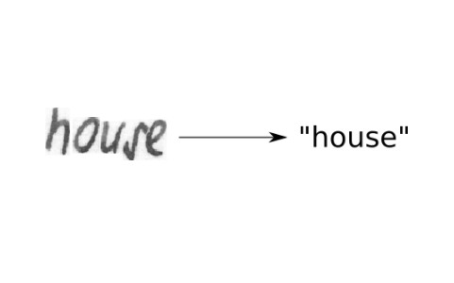
Introduction :
The ability of a computer to obtain and interpret intelligible handwritten input from sources such as paper documents, images, touch-screens, and other devices is known as Handwritten Text Recognition (HTR). Optical scanning (optical character recognition) or intelligent word recognition can detect the image of written text "off line" from a piece of paper as shown in the
Alternatively, the motions of the pen tip may be detected "on line," for example, by a pen-based computer screen surface, which is a more straightforward task since there are more hints available. A handwriting recognition system takes care of encoding, character segmentation, and finding the most probable words.
Manually written Text Recognition is a breakthrough that is desperately needed right now. We relied on drafting writings on our own prior to the proper implementation of this invention, which may have resulted in some errors. It's difficult to keep things secure while still collecting data effectively

Slide 6
Existing Work :
Optical character recognition for English handwritten Text Using Recurrent Neural Network
The character arrangement is discovered using a recurrent neural network.
The performance of the RNN algorithm is printed text with a 90% accuracy
Handwritten Character Recognition to Obtain Editable Text
The key challenge is to identify the characters in various handwriting types. As a result, a framework
is created that recognises handwritten data and converts it into editable text
Recognition of cursive English handwritten characters
The characters in a word are linked together in cursive English handwriting. As a result, it's incredibly
difficult to divide and extract features from cursive English writing
Algorithm for optical character recognition based on structural components extraction
There has been a proposal for a character topology composition algorithm. Character graph
comparison metrics have been proposed
Handwritten word recognition based on structural characteristics and lexical support
This paper presents a handwritten recognition algorithm based on structural features, histograms,
and profiles.

Slide 7
Proposed Work :
Handwriting differs from person to person. All of those documents have been gathered and scanned into those datasets. Crop each character physically and label each character as a different image from these. After that, it's used for OCR (optical character recognition). As mentioned in the above chapter, OCR goes through pre-processing, classification and post processing.
Reformat the image to 30*30 pixels and transform it to grayscale. Force pixels to change. Include 2 pixel padding on all sides. It's a 12832-pixel grayscale image.
Normally, the images from the dataset aren't exactly this size, so we adjust them till they're either 128 pixels wide or 32 pixels tall.
Indications for this surgery can be found in. The increase in information can be easily coordinated by duplicating the image to irregular conditions rather than moving it to one side or arbitrarily resizing it.

Slide 8
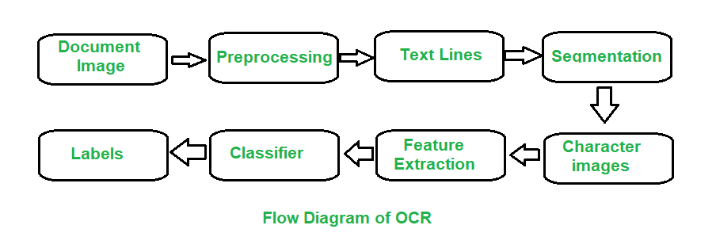
Methodology:
The main technology we used here is OCR. This OCR is the most common example of machine learning.
Optical Character recognition is a promising technology that is used to convert the letters or words written using hand into a digital format.
It is a common method of digitizing printed texts so that they can be electronically edited, searched, stored more compactly, displayed on-line.
How Does OCR Work?
Pre-processing
Feature Extraction
Post-processing

Slide 9
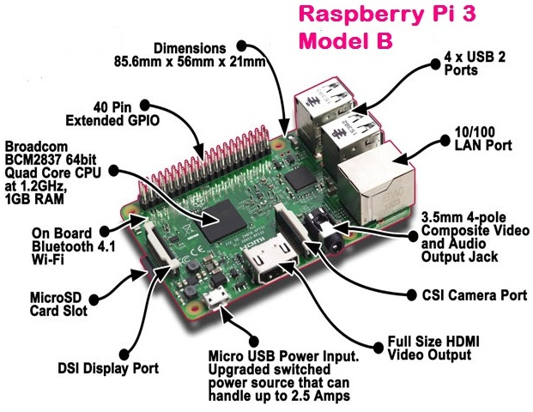
Requirements:
Hardware Requirements :
A computer with –
Core i3 processor
2GB RAM
250GB harddisk
OCR
Raspberry pi 3 Model B
pi camera

Slide 10
Working :
We start by reading the image using the pi camera. Firstly, a colour image is captured from the camera module or the prestored version of the image is converted to grayscale levels by using a black and white conversion method.
Then this grayscale level image underwent thresholding such that pixels having values less than 0.4 for in our case is removed.
More often these pixels are redundant and have no major effects on the image but our data to be processed it reduced and image artifacts such as dots and graininess is reduced.
Third process is that our images are compared with the character set that are prestored in our database. These kinds of data sets are easily available online for various fonts and styles.
Next the next step involves understanding each letter and converting them. It is stored separately. The file is generated with all the converted letters.

Slide 11
Decoding:
First, we import the required packages for this project: The OpenCV library helps to show the frames in the output window
Pytesseract is a Python wrapper for Tesseract — it helps extract text from images.
The other two libraries get frames from the Raspberry Pi camera
Then we initialize the camera object that allows us to play with the Raspberry Pi camera. We set the resolution at (640, 480) and the frame rate at 30 fps.
PiRGBArray() gives us a three-dimensional RGB array organized (rows, columns, colors) from an unencoded RGB capture. The advantage of using PiRGBArray is that it reads the frames from the Pi camera as NumPy arrays, making it compatible with OpenCV. It avoids the conversion from JPEG format to OpenCV format which would slow our process.
The code contains two arguments: the first is the camera object and the second is the resolution.
rawCapture = PiRGBArray(camera, size=(640, 480))
After that, we use the capture_continuous function to start reading frames from the Raspberry Pi camera module

Slide 12
cv2.waitkey() is a keyboard binding function and it waits for a specified number of milliseconds for any keyboard event. It takes only one argument which is the time in milliseconds. If a key is pressed during that time, the program will continue. Passing 0 means it will wait infinitely for a key.
Next, we clear the stream in preparation for the next frame by calling truncate (0) between captures.
rawCapture.truncate(0)
The code will then keep on looping until 'S' on the keyboard is pressed. When 'S' is pressed, it takes the last frame and extracts the text from the image. After extracting, it shows it on the terminal

Slide 13
Thankyou
&
Queries ?

